Slide 1


Quality Manual
Training material provided by Austrian Pharma Services

Slide 2
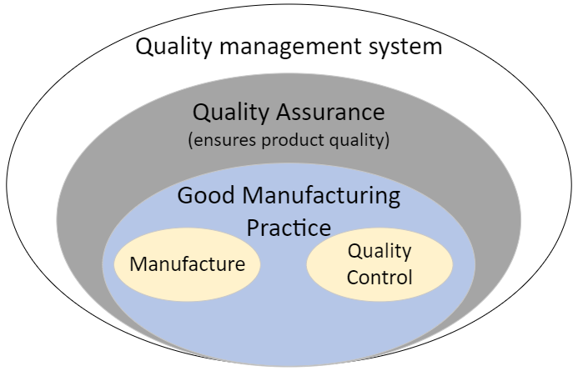
Quality Management
Quality Manual
  describes the Quality Organization and Quality Management System (QMS) including management responsibilities associated with it
Definition Quality management system (QMS)
  system for ensuring that products are
  consistently produced and controlled
  according to quality Standards/
  Regulations/Directives (WHO, PIC/S, ICH Q10,
  21-CFR Part 210/211 (US-FDA),
  EudraLex - Volume 4-Good Manufacturing Practice (GMP) guidelines (European Commission), etc.

Slide 3
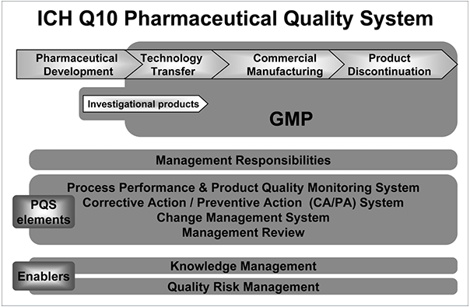

Slide 4
ICH Q10 Model
Implementation of the Q10 model should result in the achievement of three main objectives:
Achieve product realization
To establish, implement and maintain a system that allows the delivery of products with the quality attributes appropriate to meet the needs of patients, healthcare professionals, regulatory authorities (including compliance with approved regulatory filings), and other internal and external customers
Establish and maintain a state of control
To develop and use effective monitoring and control systems for process performance and product quality, thereby assuring continued suitability and capability of processes.
Facilitate continual improvement
To identify and implement appropriate product quality improvements, process improvements, variability reduction, innovations, and pharmaceutical quality system enhancements, thereby increasing the ability to fulfill quality needs consistently

Slide 5
ICH Q10 Model
Two Enablers will facilitate the achievement such objectives by providing the means for science and risk-based decisions related to product quality:
Knowledge management
Product and process knowledge should be managed from development through the commercial life of the product up to and including product discontinuation. Knowledge management is a systematic approach to acquiring, analyzing, storing, and distribution information related to products, manufacturing processes, and components. Sources of knowledge include, but are not limited to prior knowledge (public domain or internally documented); pharmaceutical development studies; technology transfer activities; process validation studies over the product lifecycle; manufacturing experience; innovation; continual improvement; and change management activities.
Quality risk management
Quality risk management is integral to an effective pharmaceutical quality system. It can provide a proactive approach to identifying, scientifically evaluating, and controlling potential risks to quality. It facilitates continual improvement of process performance and product quality throughout the product lifecycle. ICH Q9 provides principles and examples of tools for quality risk management that can be applied to different aspects of pharmaceutical quality.

Slide 6
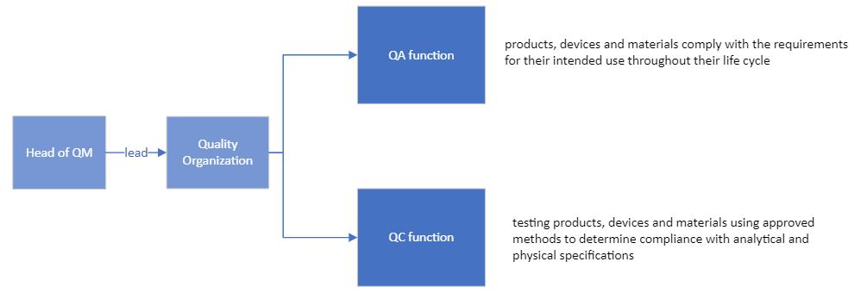
Quality Organization
an independent function responsible for the development, implementation, and maintenance of the QMS
responsible for Quality Assurance (QA), Quality Management (QM) and Quality Control (QC)

Slide 7
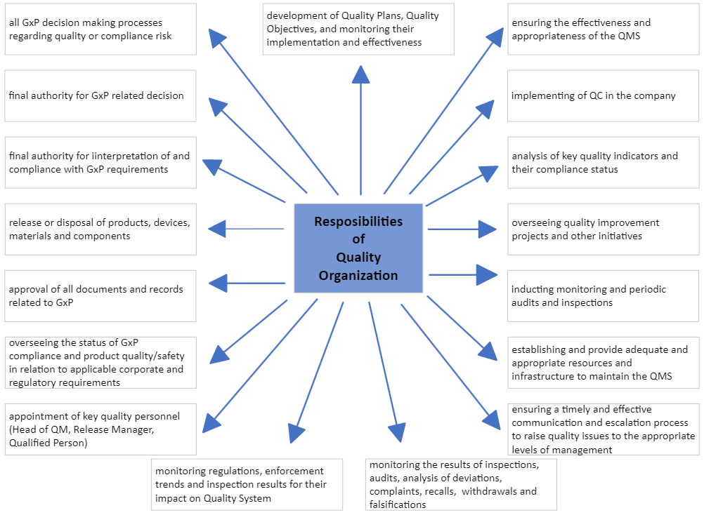

Slide 8
Governance
Executive Committee (Leadership Team)
  C-level representative (Chief…)
    long-term planning and strategy for quality and compliance
    the quality plan and strategy for Quality Organization
    compliance with applicable laws, regulations, and corporate policies
    quality plan that includes review, approval, monitoring of implementation effectiveness
Quality Steering Team
  highest-ranking Quality Leader, direct reports, quality functional managers
    communicating regulatory and QMS requirements throughout the organization
    updates to leaders and the Quality Organization on the effectiveness/changes required to the QMS

Slide 9
Governance
Management review
  The continued suitability, adequacy, and effectiveness of the QMS is ensured through periodic reviews of the Quality Plan(s), key performance indicators (KPIs), and product quality
  consist of the following representatives
    Chief Executive Officer (CEO), Chief Financial Officer (CFO), Head of Manufacturing, Head of QM, and Head of Regulatory Affairs (RA)
  Management Review meetings
    by the Quality Organization on at least an annual basis
    to assess the ongoing suitability and adequacy of the QMS
    to identify risks and/or opportunities for continuous improvement

Slide 10
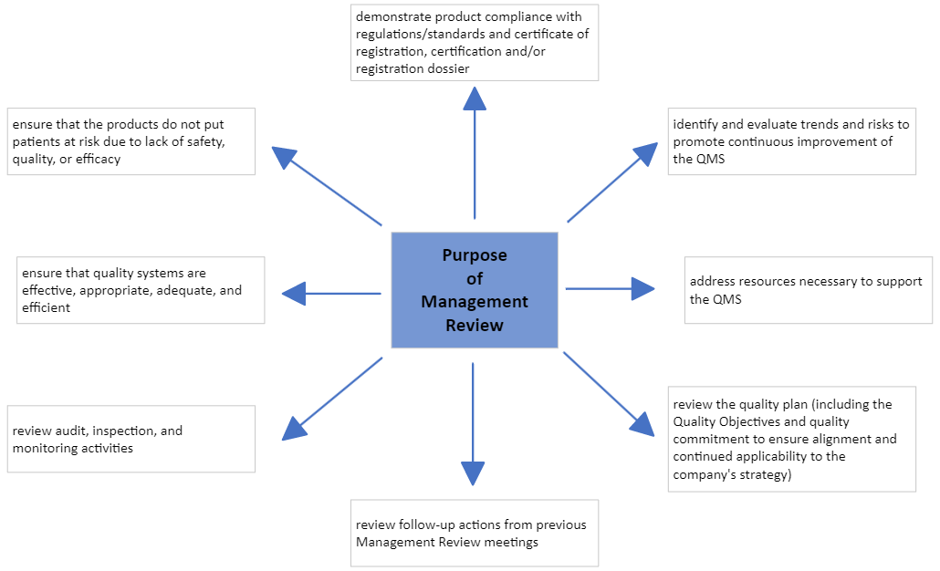

Slide 11
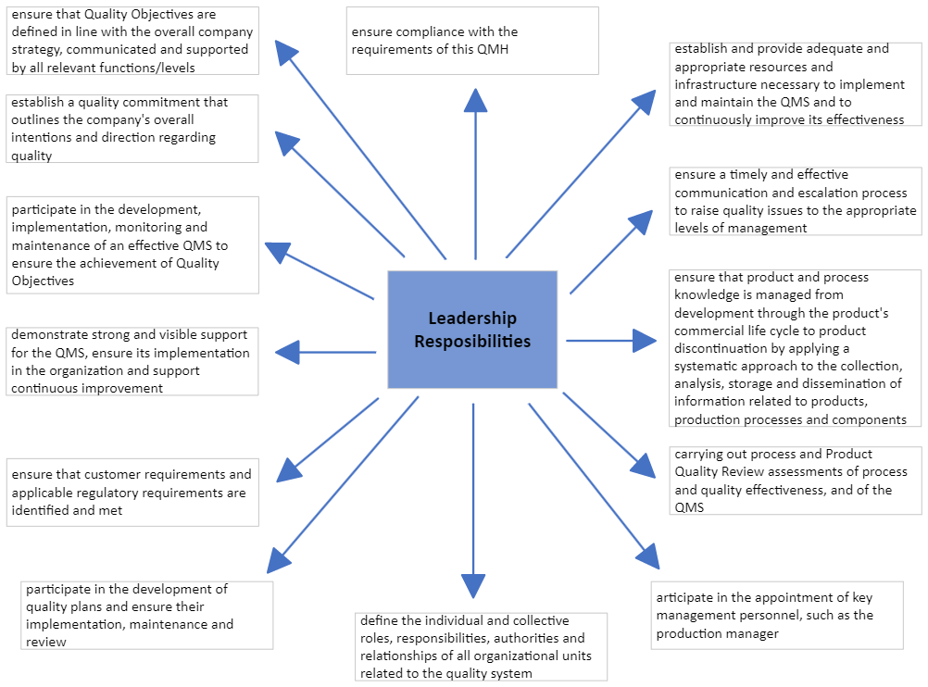

Slide 12
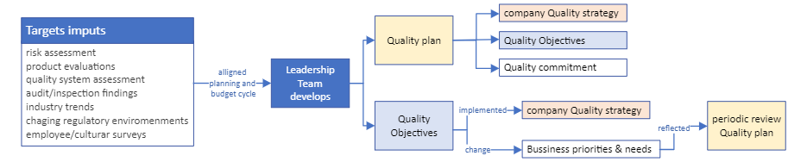
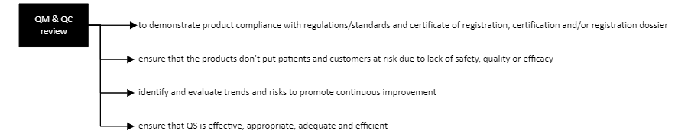
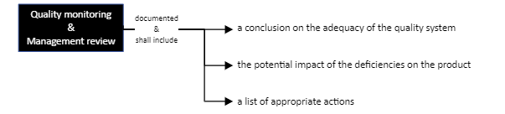
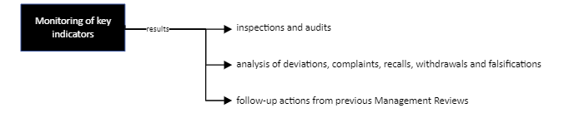
Quality Strategy and Planning

Slide 13
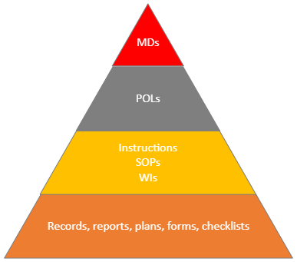
Documentation of the QMS
Master Documents (MDs)
  basic description of the company quality concept
Policies (POLs)
  description in general terms, of how specific GMP aspects
  (security, documentation, health, and responsibilities)
  will be implemented
Instructions
  Standard Operation Procedure (SOP)
    Mandatory, approved description of a company-specific work process
  Working Instruction (WI)
    Written instruction describing the individual/specific steps of recurring operations
Records, reports, plans, forms, checklists
  Documents for resulting activity

Slide 14
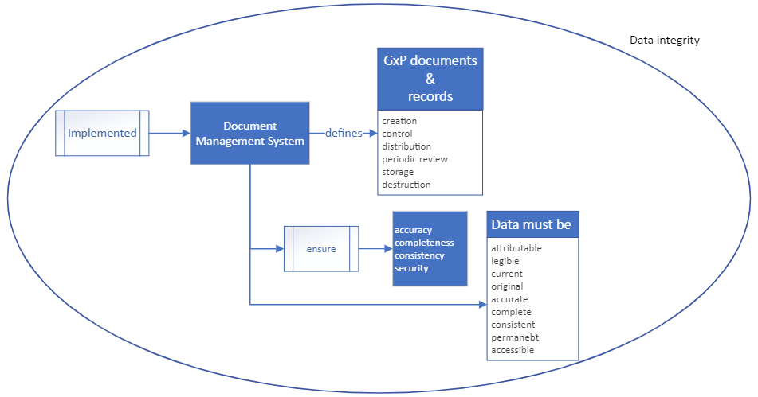
Fundamental Quality Systems and Processes
Quality Risk Management (QRM)
A QRM process is to be established to provide a proactive approach to identifying potential risks to the quality, safety, and effectiveness of products and processes. As part of the assessment, the quality risk assessment considers the severity and impact of the event. Results of risk assessments are implemented, as necessary, in quality plans or CAPAs.
Data and records

Slide 15
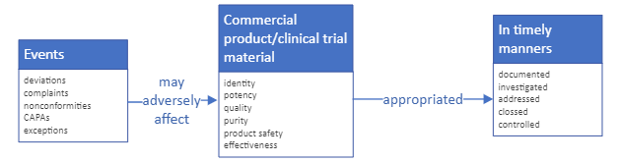
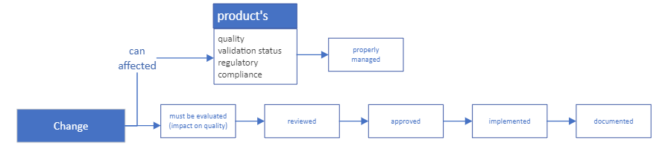
Fundamental Quality Systems and Processes
Events
Change management

Slide 16
Fundamental Quality Systems and Processes
Audits and Inspections
  Programme for auditing internal/external service providers/contractors and self-audits
Escalation Event Management
  Of quality-related issues to the appropriate management level
  Assessment of the need for market action related to quality and compliance issues (recalls, withdrawals)
  Informing regulatory authorities of product quality and compliance issues, as required by applicable law

Slide 17
Fundamental Quality Systems and Processes
Material management
  Procedures to control components used in manufacture/development of product
  To receive, process, store, control and release material throughout product life cycle
  To ensure that the product is approved and released by responsible person
3rd party management
  To control outsourced GxP activities and quality of purchased materials
  Process should include
    selection, evaluation, monitoring and control of 3rd parties and materials

Slide 18
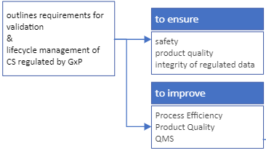
Fundamental Quality Systems and Processes
Computerized systems (CS)
A system is in place that outlines the requirements for validation of computerized systems and lifecycle management of computerized systems regulated by GxP to ensure patient safety, product quality, and the integrity of regulated data. Continuous Improvement of Process Efficiency, Product Quality, and Quality Management System

